Slide 1
Environment key points
mycoprotein

Slide 2
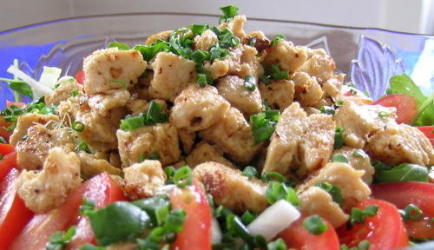
Mycoprotein is a
protein-rich food that has been developed as an alternative to meat in a vegetarian diet. It is produced using a fungus called Fusarium.
Mycoprotein is a single-celled protein. It consists of cells of Fusarium that have been treated to create the final product.
The fungus is grown in aerobic conditions and carbohydrate is provided for food. After growth, the biomass is harvested and purified. It can then be flavoured and shaped.
Notes:
Photo credit: salsachica
Teacher notes
In order to inhibit the growth of bacteria, the fungus is grown at a low pH. The equipment is sterilized before use to reduce the risk of contamination.

Slide 3
Mycoprotein
The fungus Fusarium can be used to produce a protein rich food called mycoprotein
Fusarium lives in soil and feeds on detritus
Its body consists of microscopic thread like structures called hypae
They grow on glucose syrup in aerobic conditions and reproduce very quickly
The biomass(body) of the fungus is the product used to make the mycoprotein.
Describe the process of producing mycoprotein using 3 bullet points.
Give 2 reasons that mycoprotein makes a good meat substitute for vegetarians.

